Slide 1

E-Learning Platform(ELP)
Topic one
Topic two
Topic three
Topic four
Project Mentor
Dr. Arun Kumar Tripathi
Project Leader
Kajal Punia
Team Members
Aparna Singh
Niharika Baliyan

Slide 2
Project Overview
ELP is a responsive website offering various courses to study online. This platform is designed for the particular need of a college to use the functionalities or operations in a smooth manner.
ELP is easy to use for instructors and students i.e. no formal knowledge is needed to use the platform thus by this all it proves it is user-friendly. This platform reduces errors while entering the data by providing error messages as a user enters invalid data. ELP can lead to secure, fast and error free system. It will help a college to manage or utilize resources and time. This platform allows students to study at their own place. Students can view the course from this platform and instructor can upload and update the course.

Slide 3
Modules:
Registration
Login
Courses
Enrol in courses
Instructor
Admin
Student

Slide 4
Development environment
HARDWARE:
SOFTWARE:
Processor i5
RAM 8GB
HDD space 1TB
Internet connection with minimum 2Mbps
Web Browser(Latest version)
Windows 10 and above
iOS 12 and above
Android 5.0 and above

Slide 5
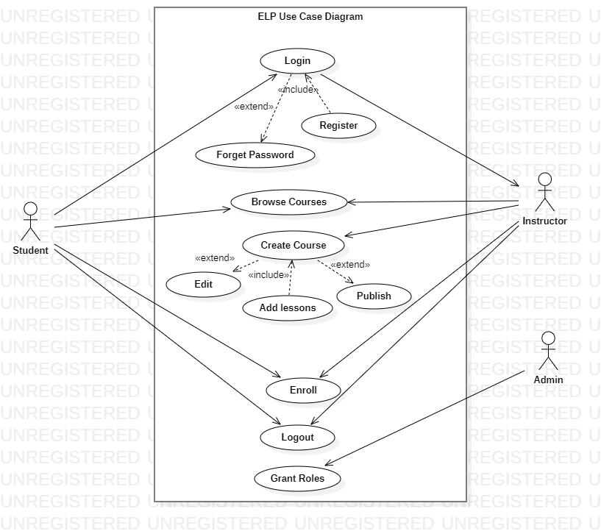
UML Use Case Diagram

Slide 6
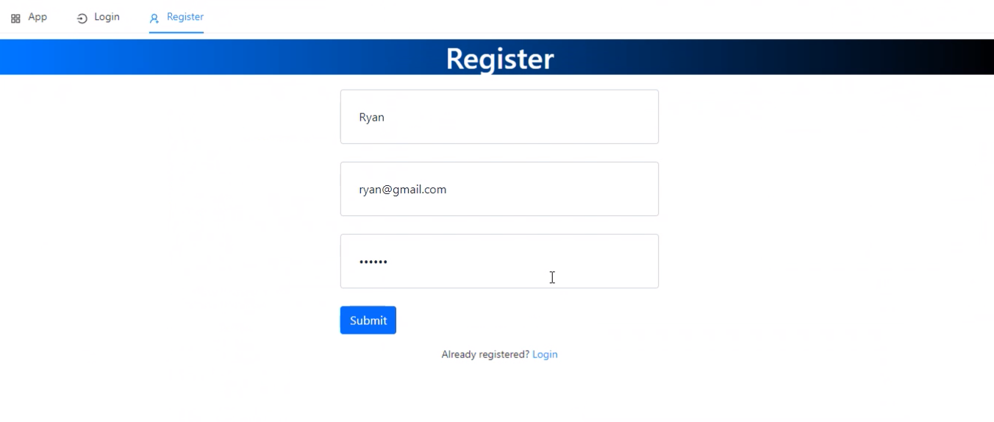
Progress

Slide 7
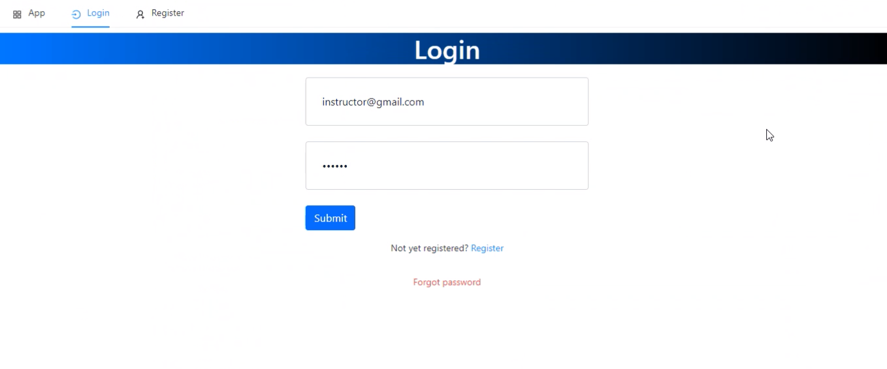
Progress

Slide 8
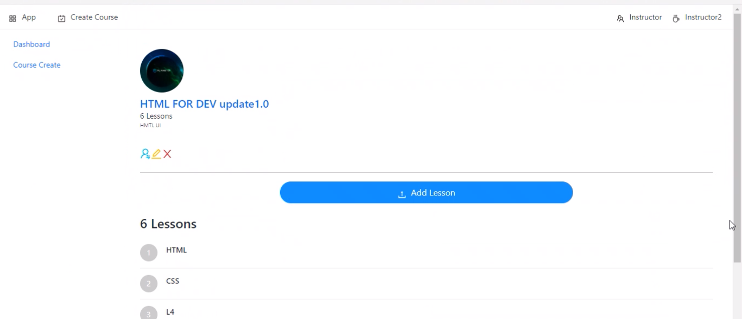
Progress

Slide 9
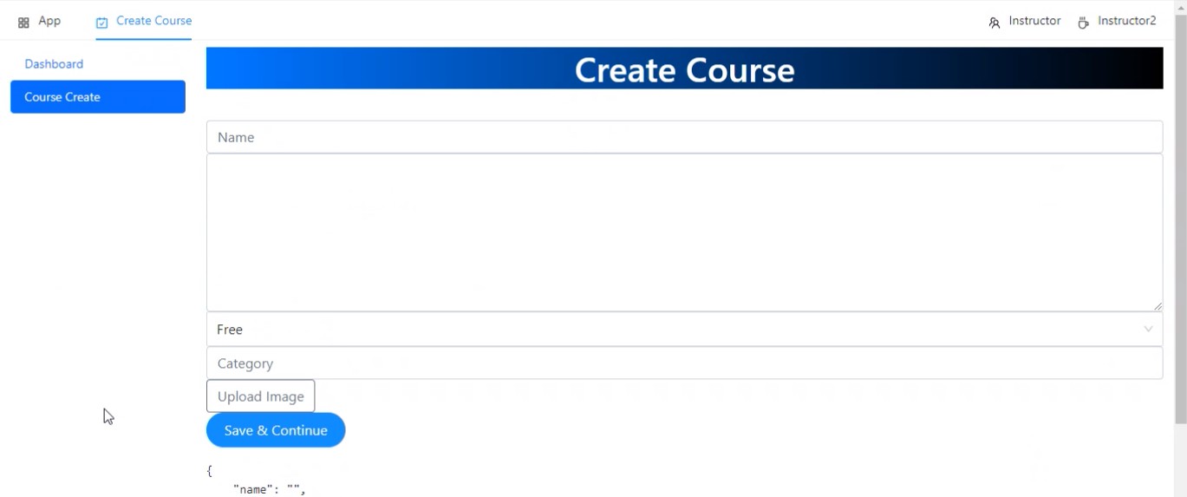
Progress

Slide 10
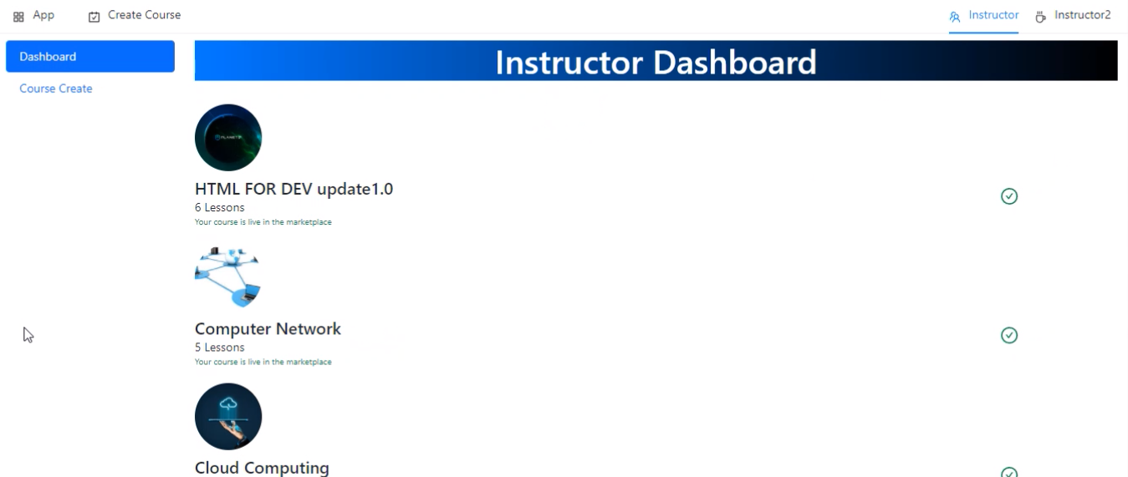
Progress

Slide 11
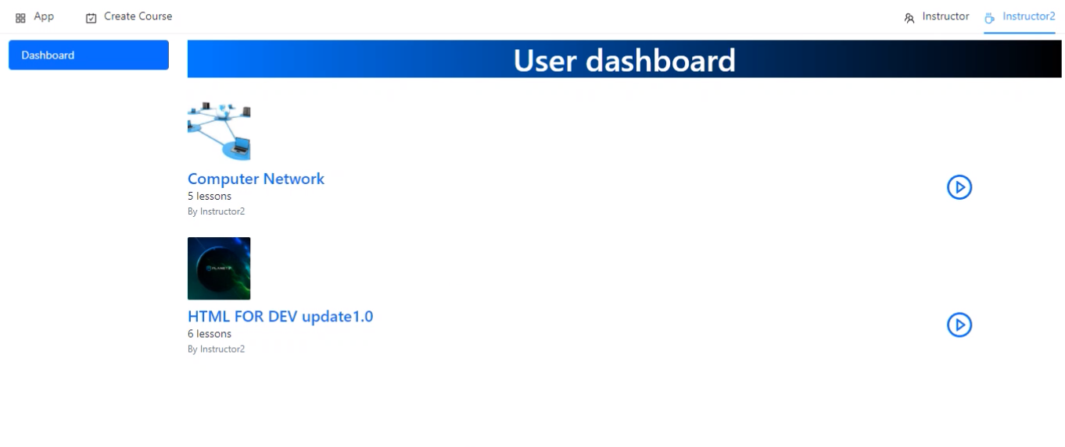
Progress

Slide 12
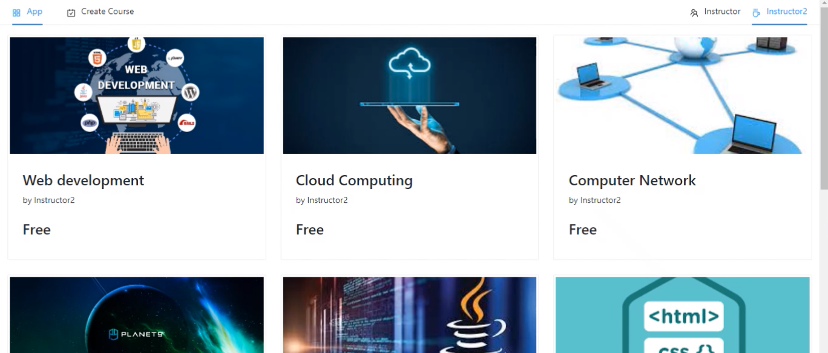
Progress

Slide 13
Benefits to Society
* This platform keeps you up to date with technology.
* ELP teaches innovative ways to collaborate.
* E learning improves time management skills.
* ELP saves time and money.
* ELP offers personalization.

Slide 14
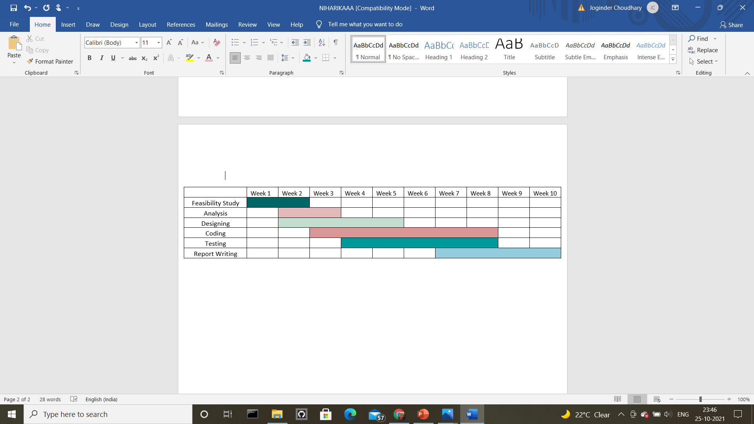
Gantt Chart

Slide 15
THANK YOU

